Slide 1
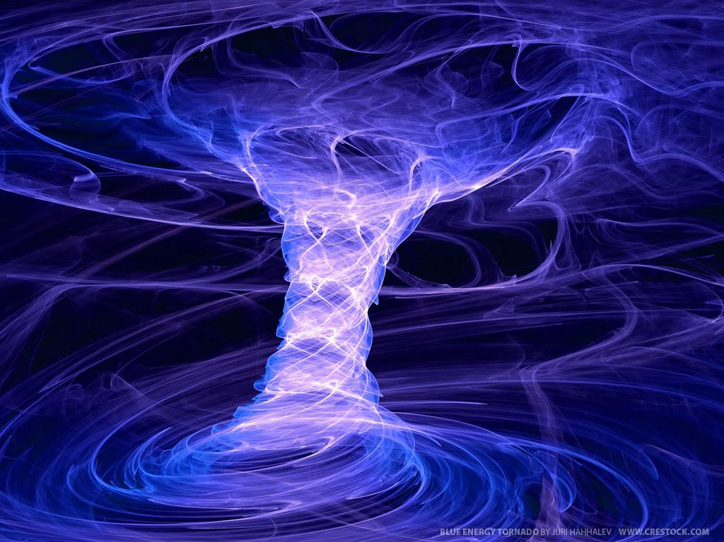
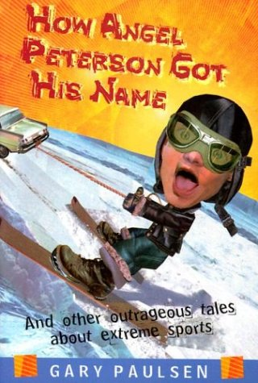
HOW ANGEL PETERSON GOT HIS NAME: CHAPTER 4
Girls and the Circle Of Death

Slide 2
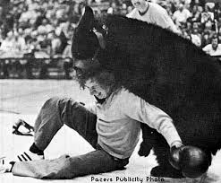
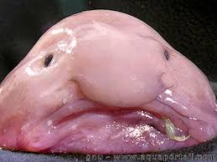
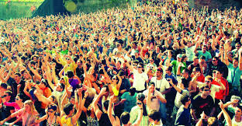
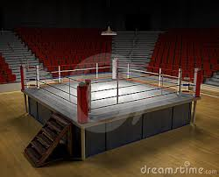
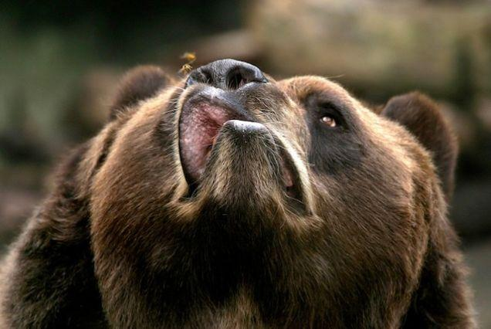
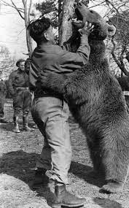
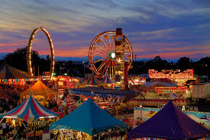
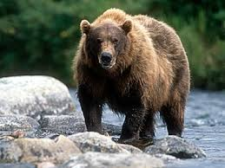
Pictures

Slide 3
Summary
Orvis tries to wrestle a bear because there were girls around. He loses the first time but wins the second time and then the girls liked him.

Slide 4
What was the risk and Why he took the risk
The risk Orvis took was that he wrestled a bear. He was encouraged because girls were around.

Slide 5
Was it a good risk ?
I do not think it is a good risk because he could have seriously injured himself by wrestling the bear, and he was not doing it for a good enough reason.

Slide 6
Would I take this risk? And why?
NOPE . It would be very risky. Seriously, no girl is worth fighting a bear for. You would badly hurt yourself. Of course, I'm guessing people then were, and I don't mean to offend anyone, CRAZY.

Slide 7
A sentence from the book that stood out
“Give me another quarter. . . now . “I don’t think this is a good idea!” NOW!”
This stood out to me because he was so willing to do something like that again after what happened his first time in THE CIRCLE OF DEATH.

Slide 8
How does this relate to our time?
For starters, most fairs probably don’t offer bear wrestling anymore. I think people were more willing to do these kinds of things and had a more open mind. People take more safety precautions and just don’t take intrest to almost dying today.

